Slide 1
HW/SW Design
Hardversko-softverski dizajn
Prof. dr Radovan Stojanović
ETF Podgorica

Slide 2
HW/SW Design
Princip rada
Orjentisan na praktičan rad i rešavanje konkretnih problema (podjela u grupe, proucavanje problema, izrada prototipa, testiarnje prototipa, pisanje rada)
Ovogodišnje tematske oblasti:
HW/SW Design of SMART Systems
SMART Agriculture
Smart Energy
Smart City
Smart Health
Smart Anything Everywhere
Technology
HW Design of analog circuit
HW/SW Design of FPGA based smart systems
HW/SW Design of MCU based smart systems
HW/SW Design of IoT based smart systems

Slide 3
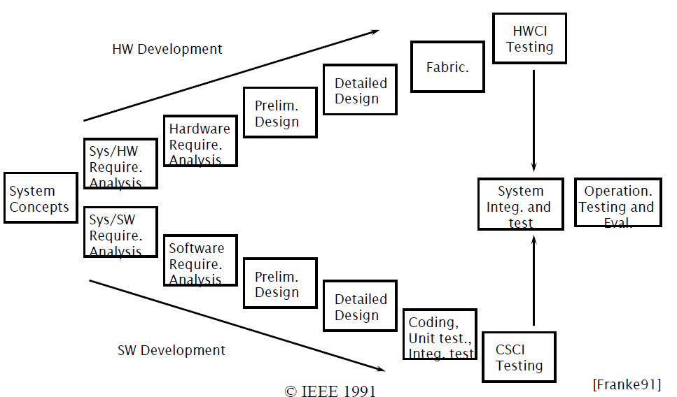
HW/SW Design Process

Slide 4
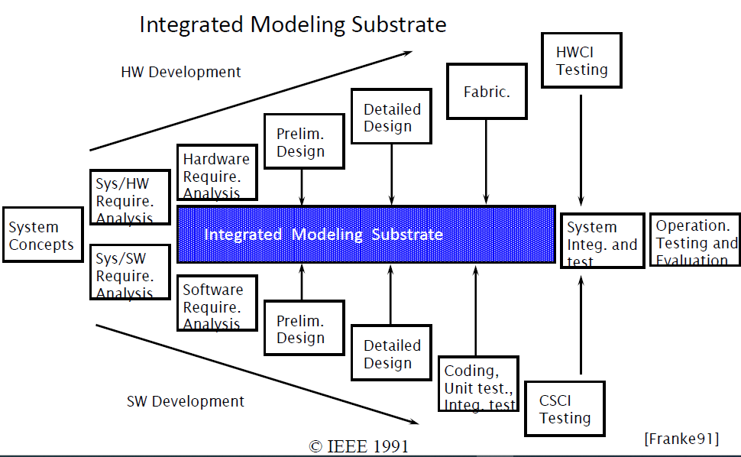
HW/SW Design, integrated modeling

Slide 5
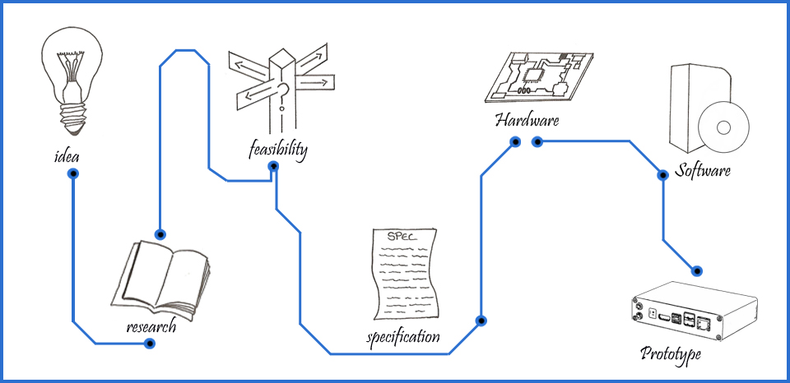
HW/SW Design
From idea to prototype (https://www.micropassion.co.uk/Prototypes.html )

Slide 6
Tematske oblasti 2021
SMART Agriculture
Chlorophyll Meter System Design
Irrigation system design
Smartphone image based digital chlorophyll meter
Smart Energy and smart home
Energy power meter
Smart security system for home
Smart City
Smart parking
Smart Health
Smart covid mask
Smart social distance metter
Smart medical kiosk
Wearable posture monitoring system
Wearable stroke detection device
Design of a portable urine glucose monitoring system
Microcontroller-Based Detection of Diabetes and Ketosis
Urine hidratation system
Non Invasive Skin Hydration Level Detection
Home oxygen machine
Oxygen sensor and measuring set
Smart Anything Everywhere
Smart sensor node (communication aspect)
Smart sensor node (energy aspect)
Smart DSP
PID Controller on FPGA for Temperature Control
Digilent FPGA board, exercises and examples

